Slide 1

High Pass Spatial Filter
EEL4720: Reconfigurable Computing
Professor:
Herman Lam
Members:
Jonathan Ganyer
Jason Lewis

Slide 2
Project Description
Objective
Takes a grey scale input image and enhances it through sharpening (high pass spatial filtering).
Approach
Mirrors source image into BRAMs using offset mirroring method to reduce controller complexity and runtime.
Implement 128-bit smart buffer to instantiate eight instances of our data path in order to substantially outperform traditional image processing methods.
Output to Putty terminal to import into MATLAB for image verification.

Slide 3
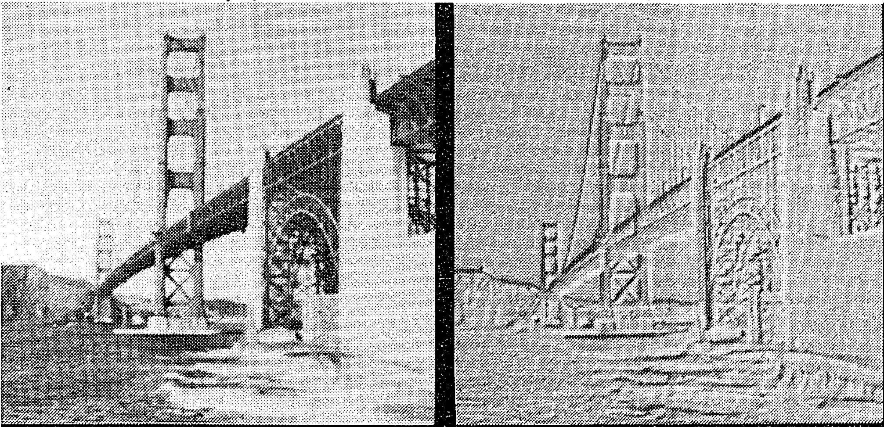
High Pass Spatial Filter Theory Explained
Pixel data with high frequency neighboring pixels are attenuated and low frequency are accentuated. The resulting image will focus on edge-sharpening.
As seen below, the sky and ocean are attenuated due to their high frequency. The bridge on the other hand, has different levels of grey due to shadows and positioning. Therefore, all the edges of the bridge are sharpened.

Slide 4
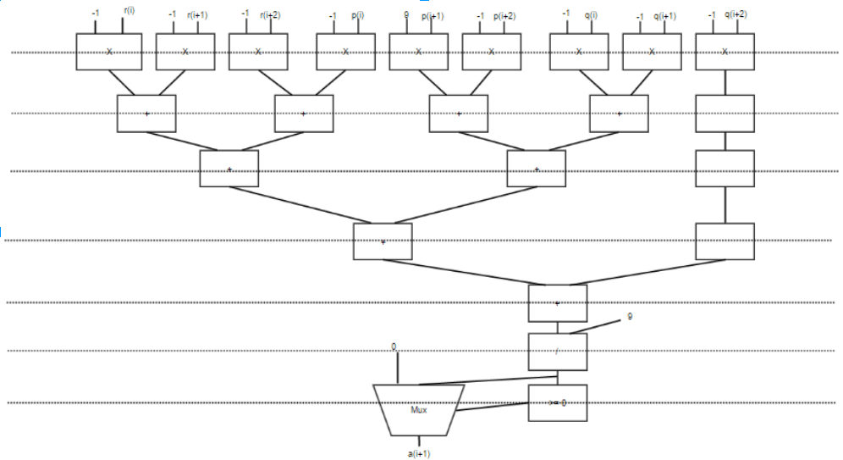
Performance Differences Why Accelerate?
Traditional methods for solving these computations involve processing the filtering algorithm sequentially. This requires a great amount of time to process as the program cannot do anything else.
The benefits of using the Zedboard as a hardware accelerator is that we can create a custom IP in our FPGA fabric to execute this specific algorithm.
Dedicated processing also means pipelining the algorithm is possible since subsequent pixels require previous pixels in the image.

Slide 5
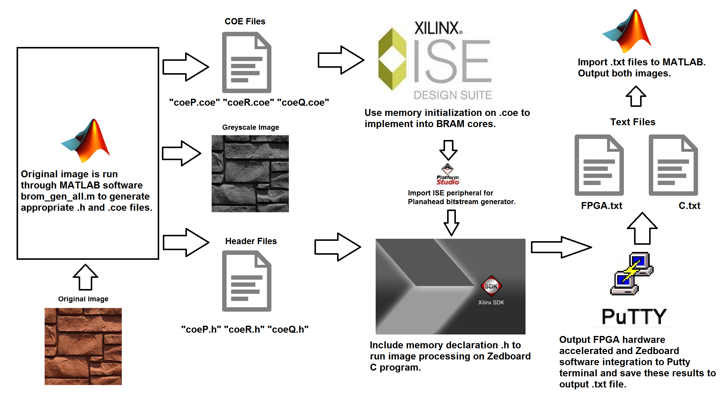
Implementation Process

Slide 6
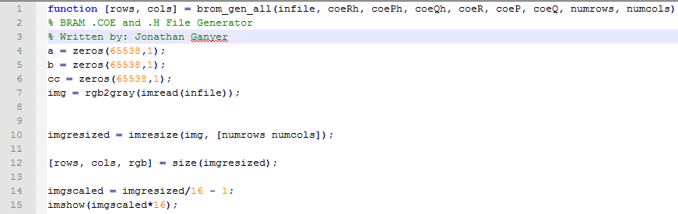
Block RAM Instantiation MATLAB Integration
We needed a way to import images we wanted to process into the Xilinx ISE environment. Using the Block RAM generator IP core, we’re able to initialize our BRAMs with .coe files.
We used MATLAB to generate the appropriate memory files we needed for our application. It was also written to take into account the formatting used by .coe files.
Likewise MATLAB was used extensively in taking the resulting image from the output BRAM and converting this into a greyscale image.

Slide 7
High Pass Spatial Filter (Algorithm Explained)
int sum;
for (i=0; i < max_col-3; i++)
{
for(j = 0; j < max_row-3; i++)
{
//Summation of 3x3 window with scaling factors applied.
sum = ( (-1) * (pixel[j][i]) ) + ( (-1) * ( pixel[j][i+1]) )+
( (-1) * ( pixel[j][i+2]) ) + ( (-1) * ( pixel[j+1][i]) )+
( (9) * ( pixel[j+1][i+1] ) ) + ( (-1) * ( pixel[j+1][i+2]) )+
( (-1) * ( pixel[j+2][i] ) )+( (-1) * ( pixel[j+2][i+1] ) )+
( (-1) * ( pixel[j+2][i+2] ) );
//Resulting pixel is the average of the summation of these values.
if ( ( sum / 9) >= 0 )
a[j+1][i+1] = sum / 9;
//If result of average was negative, make equal to zero.
else
a[j+1][i+1] = 0;
}
}

Slide 8


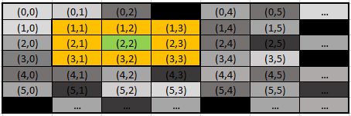

High Pass Spatial Filter Window Technique
Currently processed pixel becomes darker when peripheral pixels are lower values of grey scale.
Likewise, the pixel becomes lighter when neighboring pixels are equal values of grey scale.

Slide 9
Design and Implementation Datapath Iterations
Multiple instructions (adder, divider, multiplier, comparator) used sequentially allows for pipelining of data.
Memory constraints of the BRAM allows for up to eight iterations per clock cycle.
Architecture will take in all inputs at the same time and output a result every cycle after initial latency through pipelining. Windowing method allows for old data to be used in new computations, lowering the required bandwidth to 8-bit per additional iteration.

Slide 10
Datapath Implementation Spatial Filter Algorithm
Each data path will take 72 bits(24 bits per BRAM) and one valid bit.
Eight of nine input pixels will be multiplied by a (-1) and the remaining by (9).
Higher value = higher contrast.
Sum the products
Divide by nine
If the final is less than zero, output zero; Else output final
The data paths will have an initial latency of 9 clock cycles from which the valid out will enable the output BRAM write enable and output address generator enable.

Slide 11
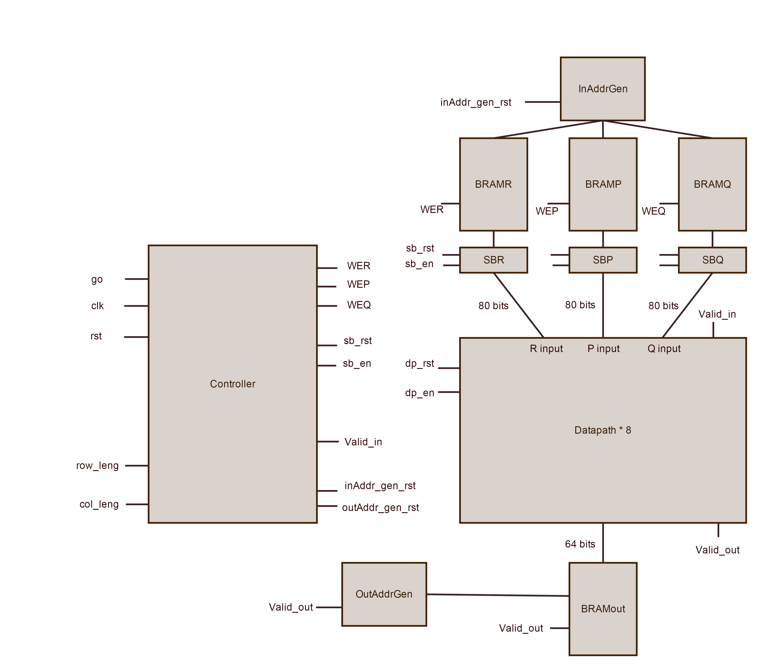
Hardware Integration Block Diagram

Slide 12
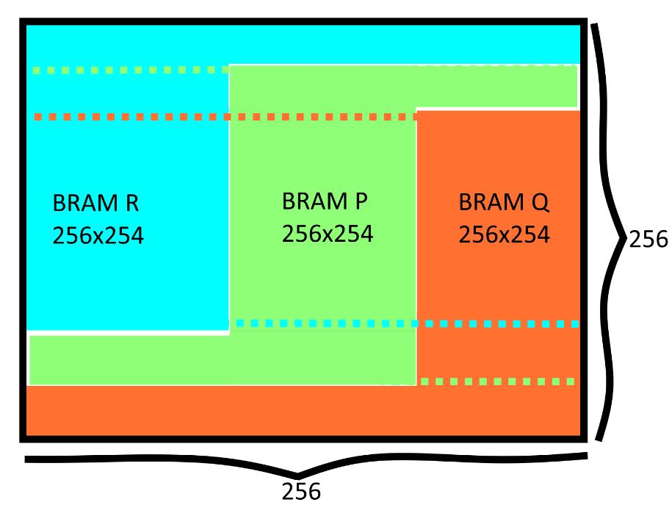
Block RAM Instantiation Mirroring Technique
Block RAMs are mirrored into three separate instances so that images can continue being processed even after row transitions. Example below uses a 256x256 image.

Slide 13
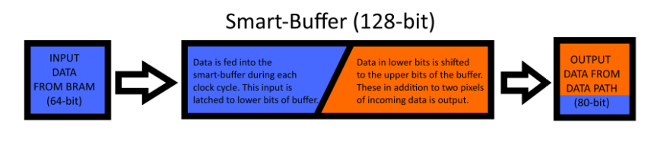
Smart-buffer Implementation FIFO Technique
Each BRAM outputs 64 bits each clock cycle so smart-buffer is needed to maximize iterations.
Each smart buffer outputs 80 bits.
Input and shift 64 bits every clock cycle.
Implementing eight iteration without starvation would need 80 bits.
Bits [64-80] necessary to prevent loss of data.
After the initial latency 64 bits are outputted from datapath and stored into output BRAM.

Slide 14
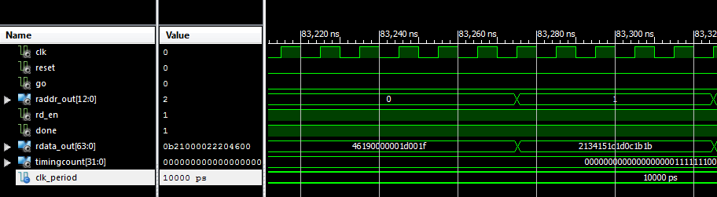
Top Level Test Bench Results
Test bench was run for the top level entity to determine if the data in the output BRAM was valid after the done signal was asserted.
Results from the signal connected to our output BRAM (rdata_out) matched those we calculated by hand.
Data was formatted with MSB being the highest pixel iteration and the LSB being the lowest.

Slide 15
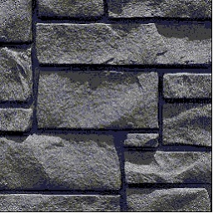
Testing and Demonstration Running the SDK
Due to memory constraints on BRAM, we will be processing a 256x256 grey scale image.
We will demonstrate that the output BRAM is receiving the correct data on the actual hardware and show that it matches our previous simulation results.
The image below of a brick wall was chosen due to its hard edges and consistent texture so that the filter could reach its full potential.
The resulting data will be read into MATLAB where a function we wrote will reconstruct it into a grey scale image that can be compared against similar results in C.

Slide 16
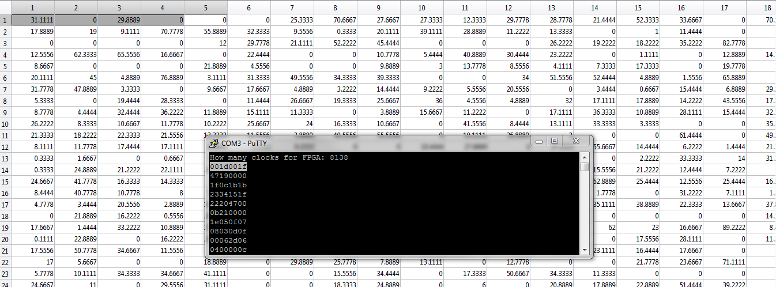
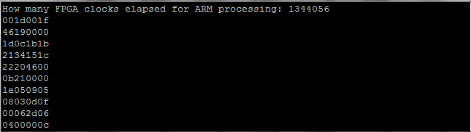
Post-Processing Memory Fetching Putty to MATLAB
Two instances of the C program outputs the clock count and output data of both the FPGA and ARM processor from Putty.
These result are stored into *.txt files where they are easily converted into images that can be displayed in MATLAB.

Slide 17
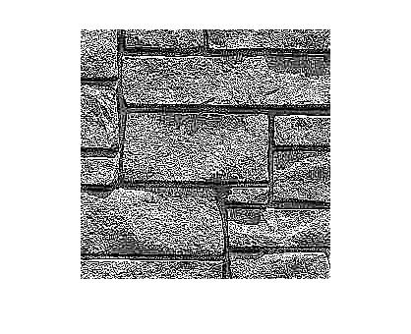
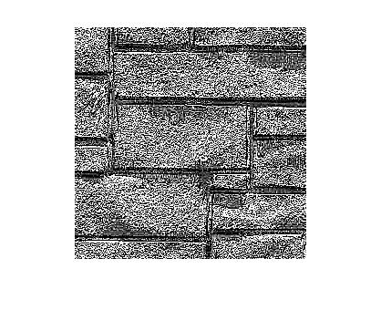


Test Results
Input Image
MATLAB Output Image
ARM Processor Image
FPGA Output Image (32-bit)
FPGA Output Image (64-bit)

Slide 18
Test Results Software/Hardware Timing

Slide 19
Test Results Hardware Timing Comparison

Slide 20
Conclusion
The use of hardware acceleration resulted in drastic throughput increases over traditional programming methods.
Using a 32-bit pipeline implementation of the High Pass Spatial Filter resulted in a 84 times throughput increase over software methods on the Zedboard.
Upgrading to a 64-bit pipeline implementation nearly doubled this, increasing to 167 times throughput compared to a C program running on the Zedboard.

